Slide 1

STEM CARNIVAL 2018

Slide 2
STEM CARNIVAL
-STEM CARNIVAL is a carnival all about Science
and mathematics.
-The meaning of STEM is: Science
Technology
Engineering
Mathematics

Slide 3

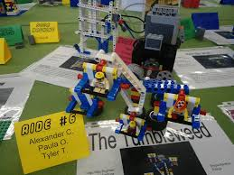
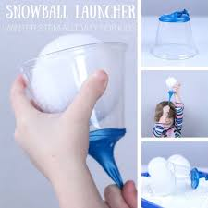
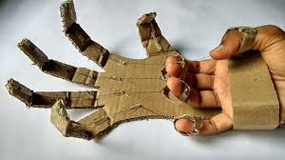
There were a lot of activities held during the carnival like:
LEGO CREATING
SNOWBALL LAUNCHER
MAKING OWN ROBOTIC HAND

Slide 4
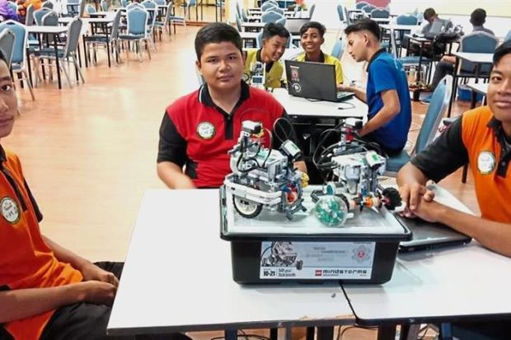
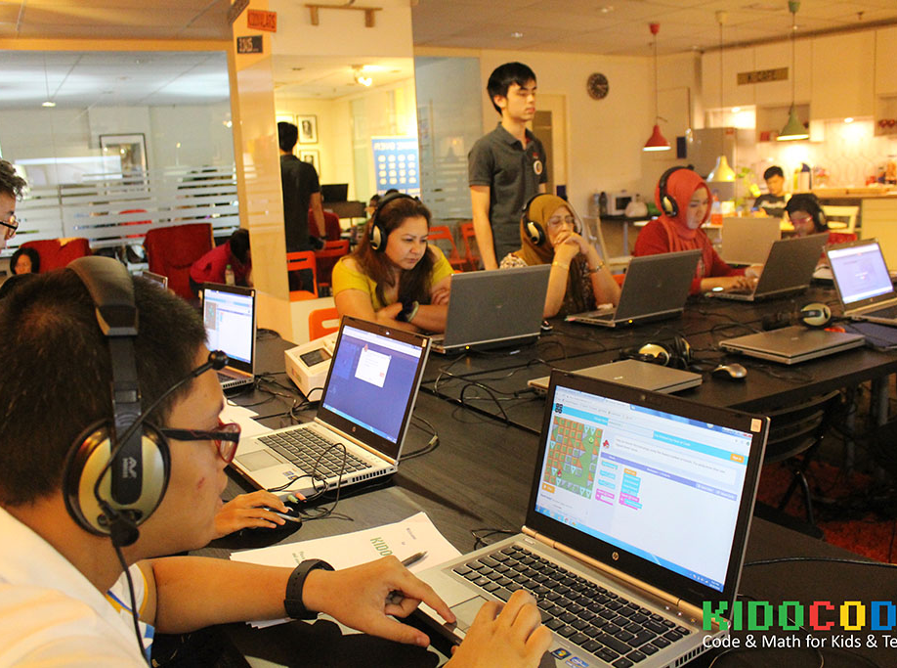
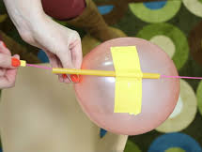
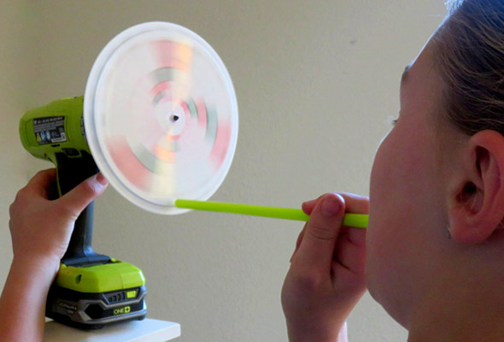
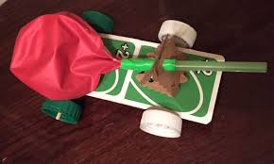
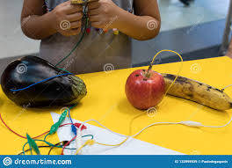
MAKING OWN ROBOTS
MAKING SCRATCH ANIMATION
MAKING BALLOON ROCKET
MAKE A BALLOON CAR
MAKING FRUIT PIANO
BUILD A DISK SIREN

Slide 5
VIDEO ABOUT STEM CARNIVAL 2018

Slide 6
PREPARED BY:
TAN WEI FENG
SYED MUHAMMAD ILHAM ARIF
MUHAMMAD HASIEF BIN NORMAN
FROM 1 BAIDURI,SMK TAMAN NUSA DAMAI

Slide 7
THANKS FOR YOUR COOPERATION DURING OUR PRESENTATION

